Slide 1


Web Development
Learning & Earning Development Project (LEDP)

Slide 2
Purpose of the Course
Make young generation skilled
Introduce to outsourcing world
Reduce unemployment
Entrepreneurship
Make us fit in local job market
Update us with the current trend of technology

Slide 3
Who provide the Course
Learning and earning development project by ICT ministry incorporate with some local IT companies

Slide 4
How to overcome unemployment by acquiring Technology Skills?
Explore freelancing marketplace
Technology + Entrepreneurship = Technopreneurship
Get job locally
Learn → Teach → Benefit society

Slide 5
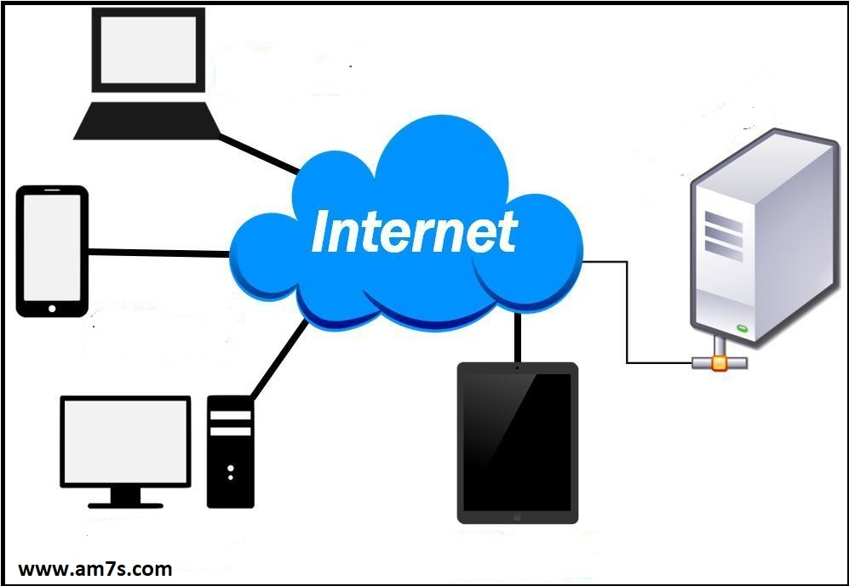
Introduction to Internet and WWW
Global computer network
Server & Client
Domain & Hosting
Languages
World wide web

Slide 6

Introduction to Web Development
Design
Development
Website
Webapp
CMS
Ecommerce
Client side
Server side
Database

Slide 7

Web Design tools and Editor
Text editor
Html editor
Adobe Dreamweaver
Microsoft Expression
Online html editor
https://html5-editor.net/
https://wordtohtml.net/
Embedded html editor
CKEditor

Slide 8
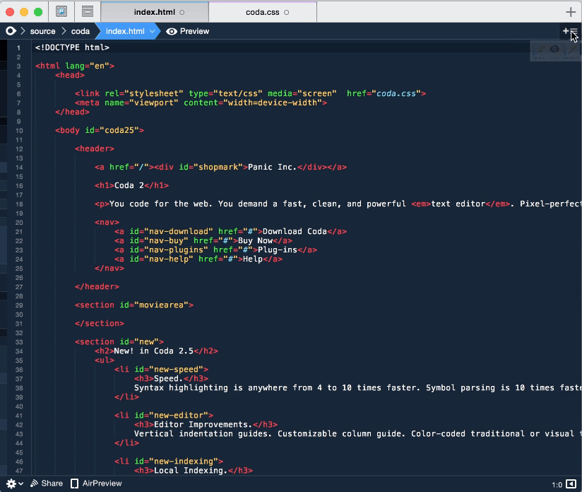
Introduction to writing code
Text editor
Language and file type
Preview
Folder structure

Slide 9

What is Online Resources?
Reading tutorial
https://www.w3schools.com/
Video tutorial
https://www.youtube.com/
Problem searching
https://www.google.com/

